Slide 1
Vector Spaces
VECTOR SPACES AND SUBSPACES

Slide 2
VECTOR SPACES
Definition: A vector space is a nonempty set V of objects, called vectors,
on which are defined two operations,
called addition
and multiplication by scalars (real numbers),
subject to the ten axioms listed on the next slide.
The axioms must hold for all vectors u, v, and w in V and for all scalars c and d.

Slide 3
VECTOR SPACES
The sum of u and v, is in V.
There is a zero vector in V such that .
For each u in V, there is a vector in V such that .
The scalar multiple of u by c, cu, is in V.
9.
10.

Slide 4
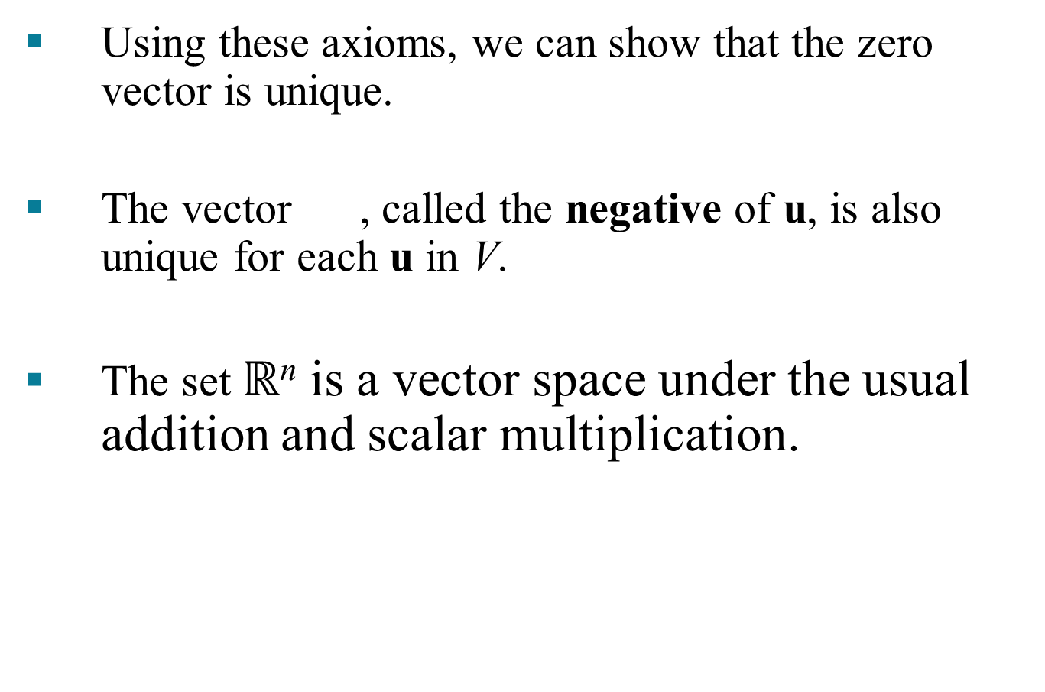
VECTOR SPACES
Using these axioms, we can show that the zero vector is unique.
The vector , called the negative of u, is also unique for each u in V.
The set $ℝ$^{n} is a vector space under the usual addition and scalar multiplication.

Slide 5
VECTOR SPACES
For each u in V and scalar c,

Slide 6
VECTOR SPACES
Example 1: Let V be the set of all arrows (directed line segments) in three-dimensional space, with two arrows regarded as equal if they have the same length and point in the same direction. Define addition by the parallelogram rule, and for each v in V, define cv to be the arrow whose length is times the length of v, pointing in the same direction as v if and otherwise pointing in the opposite direction.

Slide 7
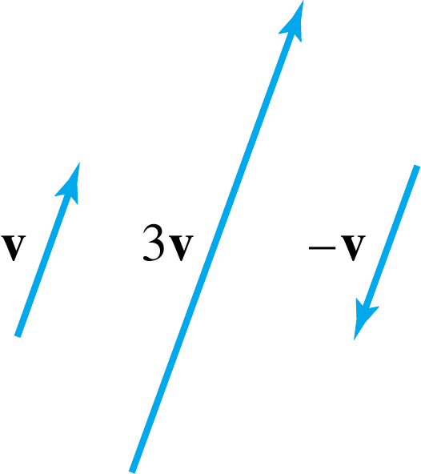
VECTOR SPACES
The definition of V is geometric, using concepts of length and direction.
No xyz-coordinate system is involved.
An arrow of zero length is a single point an represents the zero vector.
The negative of v is v.

Slide 8
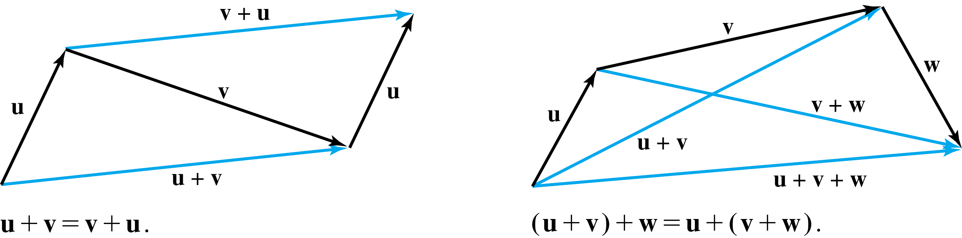
VECTOR SPACES
Axioms 1, 4, 5, 6, and 10 are evident.

Slide 9
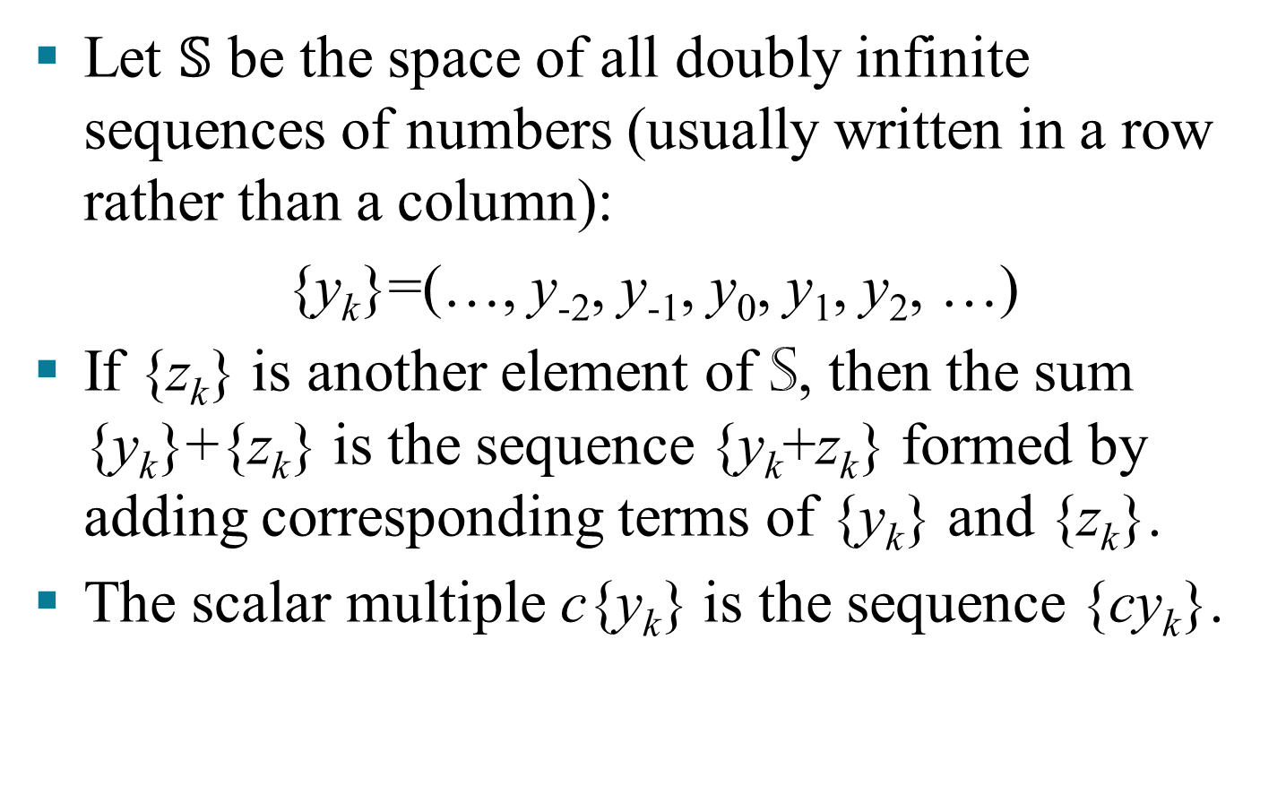
THE VECTOR SPACE OF SIGNALS
Let $𝕊$ be the space of all doubly infinite sequences of numbers (usually written in a row rather than a column):
{y_{k}}=(…, y₋₂, y₋₁, y₀, y₁, y₂, …)
If {z_{k}} is another element of S, then the sum {y_{k}}+{z_{k}} is the sequence {y_{k}+z_{k}} formed by adding corresponding terms of {y_{k}} and {z_{k}}.
The scalar multiple c{y_{k}} is the sequence {cy_{k}}.

Slide 10
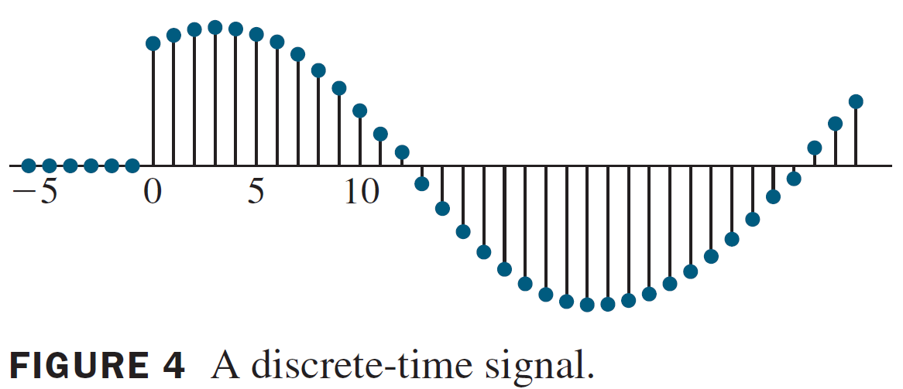
THE VECTOR SPACE OF SIGNALS

Slide 11
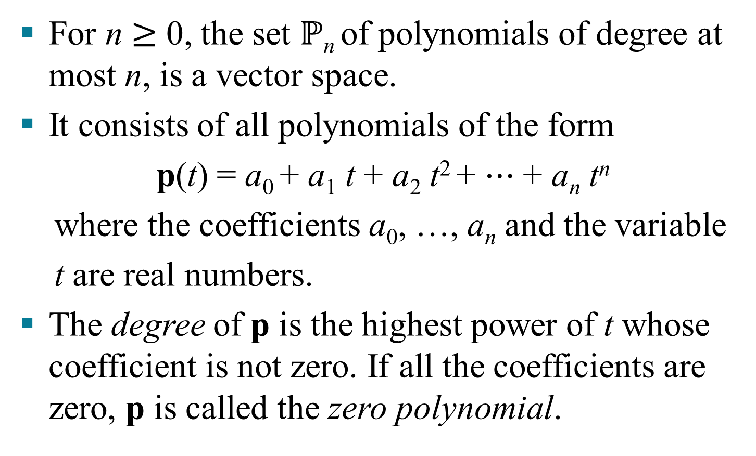
THE POLYNOMIALS OF DEGREE AT MOST n
For n $≥$ 0, the set $ℙ$_{n} of polynomials of degree at most n, is a vector space.
It consists of all polynomials of the form
p(t) = a₀ + a₁ t + a₂ t² + ⋯ + a_{n} t^{n}
where the coefficients a₀, …, a_{n} and the variable
t are real numbers.
The degree of p is the highest power of t whose coefficient is not zero. If all the coefficients are zero, p is called the zero polynomial.

Slide 12
SUBSPACES
Definition: A subspace of a vector space V is a subset H of V that has three properties:
The zero vector of V is in H.
H is closed under vector addition. That is, for each u and v in H, the sum is in H.
H is closed under multiplication by scalars. That is, for each u in H and each scalar c, the vector cu is in H.

Slide 13
SUBSPACES
Properties (a), (b), and (c) guarantee that a subspace H of V is itself a vector space, under the vector space operations already defined in V.
Every subspace is a vector space.
Conversely, every vector space is a subspace (of itself and possibly of other larger spaces).

Slide 14
SUBSPACES
The set consisting of only the zero vector in a vector space V is a subspace of V, called the zero subspace and written as {0}.
Recall that the term linear combination refers to any sum of scalar multiples of vectors, and
Span {v₁,…,v_{p}}
denotes the set of all vectors that can be written as linear combinations of v₁,…,v_{p}.

Slide 15
A SUBSPACE SPANNED BY A SET
Example 2: Given v₁ and v₂ in a vector space V, let
. Show that H is a subspace of V.
Solution:
The zero vector is in H, since .
Take two arbitrary vectors in H, say
and , then
is in H.
c. If c is any scalar, is in H.
Thus H is a subspace of V.

Slide 16
A SUBSPACE SPANNED BY A SET
Theorem 1: If v₁,…,v_{p} are in a vector space V, then Span {v₁,…,v_{p}} is a subspace of V.
We call Span {v₁,…,v_{p}} the subspace spanned (or generated) by {v₁,…,v_{p}}.
Given any subspace H of V, a spanning (or generating) set for H is a set {v₁,…,v_{p}} in H such that
.

